Slide 1

Hotel Booking Cancellation Prediction
Using the K-Nearest Neighbors (KNN) Classification Algorithm
Presented by: Savita Kumari
Guide: Mr Vikas Goel
Naviotech Solution

Slide 2


Problem Statement
Why hotels need to predict booking cancellations
The Business Problem
A Note on Scope
Guests often cancel hotel bookings after reserving a room,causing:
Lost revenue from empty rooms
Poor planning for staff, food, and housekeeping
Difficulty forecasting actual occupancy
Goal: Predict, in advance, whether a booking will be cancelled — using guest, stay, and booking details available at the time of reservation.
2 / 10

Slide 3




Dataset Overview
Hotel_Reservations.csv — 36,275 bookings, 19 columns
36,275
19
0
32.8%
Total Bookings
Original Columns
Missing Values
Bookings Cancelled
Key Feature Groups
Booking Status Split
Group | Example Columns
Stay details | no_of_adults, no_of_children, weekend/week nights
Booking details | lead_time, arrival date, market_segment_type
Preferences | meal_plan, room_type_reserved, car parking
Guest history | repeated_guest, previous cancellations
Target | booking_status (Cancelled / Not Cancelled)
3 / 10

Slide 4
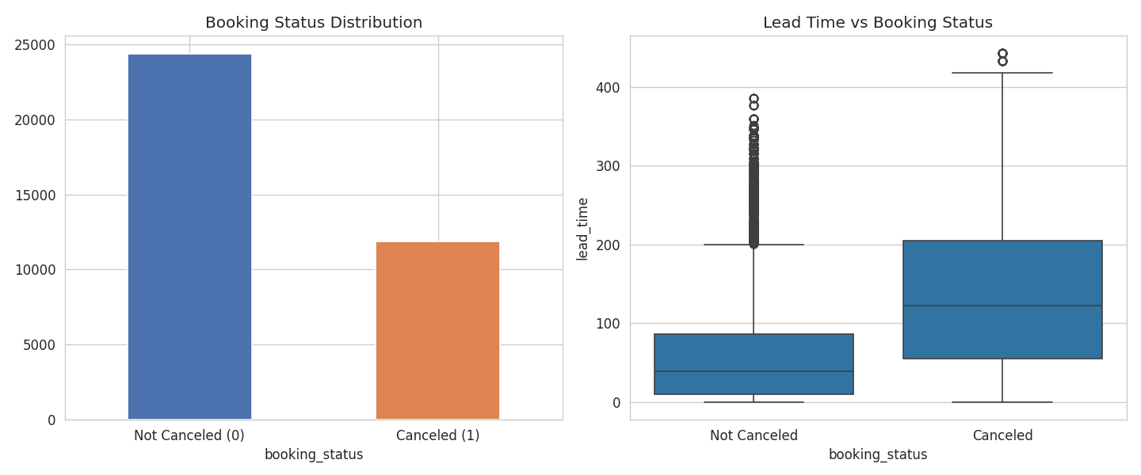
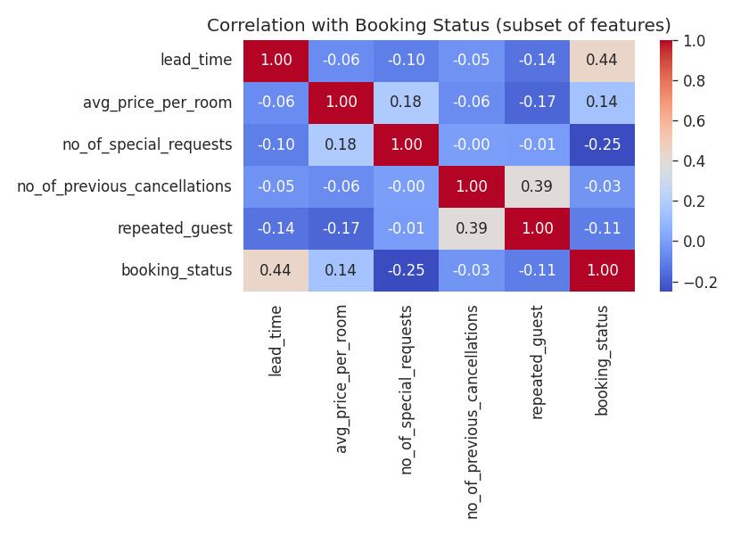

Exploratory Data Analysis
Lead Time vs Cancellation, and Correlation of Key Numeric Features
What the data tells us before we build any model
Key Observations
Key Observation
Repeat guests cancel less often than first-time guests
Class split is moderately balanced (67% / 33%) — no heavy resampling needed
Longer lead time (booked far in advance) strongly correlates with cancellation
More special requests → guests are less likely to cancel
4 / 10

Slide 5

What Is KNN?
“You are known by the company you keep”
K-Nearest Neighbors classifies a new booking by looking at the K most similar past bookings, and taking a majority vote among their outcomes.
1
2
3
4
Take a new booking
Find K closest matches
Count their outcomes
Majority wins
A booking we don't yet know the outcome for
Search past bookings most similar in features
How many of these K were cancelled vs not?
Whichever group has more votes becomes the prediction
5 / 10

Slide 6


The Distance Formula
How KNN decides which bookings are “similar”
Euclidean Distance
Why We Must Scale Data First
Like measuring with a straight ruler — the shortest direct path between two points, found using the Pythagorean theorem.
Price ranges 0–540, but repeated_guest is only 0 or 1. Without scaling, price would unfairly dominate every distance calculation.
Distance = √[(x₁-x₂)² + (y₁-y₂)² + (z₁-z₂)² + ...]
z = (x - mean) / std. dev.
Worked Example
Feature | Booking A | Booking B | Difference
Lead Time (days) | 10 | 15 | 5
Price ($) | 100 | 120 | 20
Example: price $180, average $110, std. dev. $35
z = (180 - 110) / 35 = 2.0
This price is 2 standard deviations above average — every feature now sits on a fair, comparable scale.
Distance = √(5² + 20²) = √425 ≈ 20.6
6 / 10

Slide 7
Methodology
The full process, end to end
1. Load Data
2. Clean Data
3. Encode Target
Read all 36,275 bookings from CSV
Drop Booking_ID; confirm no missing values
Cancelled = 1, Not Cancelled = 0
4. Encode Categories
5. Split Data
6. Scale Features
One-hot encode meal plan, room type, market segment
80% training (29,020) / 20% testing (7,255)
Apply standardization (z-score) to all numeric columns
7. Train KNN
8. Tune K
9. Evaluate
Model memorizes training bookings and outcomes
Test multiple K values; cross-validate to confirm
Score the model on unseen test data
7 / 10

Slide 8
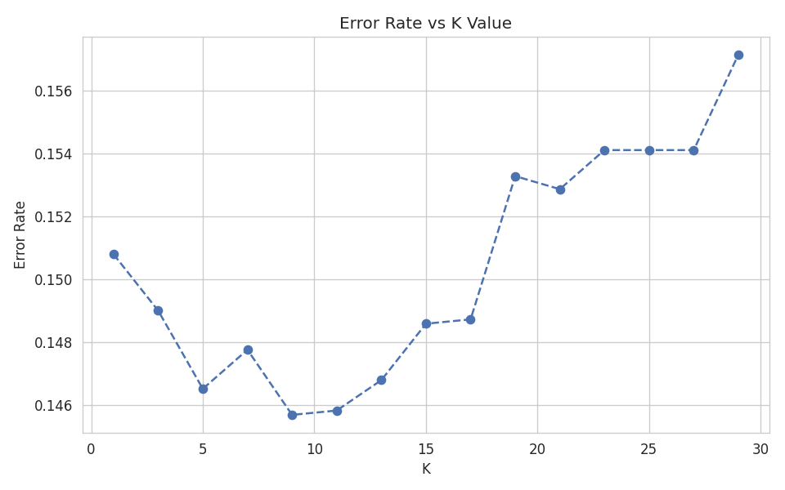

Choosing the Best K
Balancing sensitivity against generalization
How We Picked K
K too small → sensitive to noise, unreliable
K too large → too generalized, misses patterns
Tested odd K values from 1 to 29
Confirmed with cross-validation (3-fold)
Best Configuration
K = 17 • weights = distance • metric = manhattan
Error Rate vs K — lowest error occurs around K = 9–17
8 / 10

Slide 9
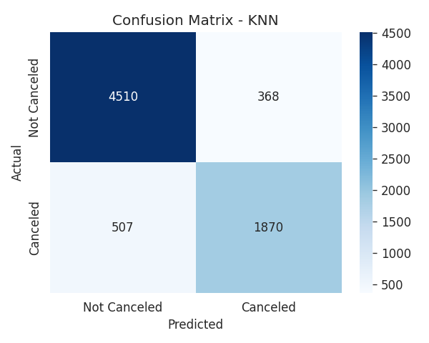
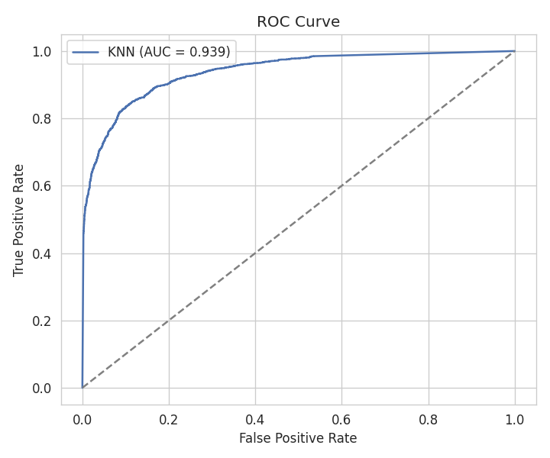

Results & Evaluation
87.9%
83.6%
78.7%
81.0%
0.939
Accuracy
Precision
Recall
F1-Score
ROC-AUC
Interpretation
The model is correct ~88% of the time, catches 4 of 5 real cancellations, and shows strong (0.939) separability between classes overall.
9 / 10

Slide 10

Conclusion
A tuned KNN model (K=17, distance-weighted, Manhattan distance) predicts hotel booking cancellation with 87.9% accuracy and 0.939 ROC-AUC on data it has never seen.
Business Use
Key Signals
Beyond Hotels
Flag high-risk bookings early for confirmation calls, deposits, or incentives
Lead time, room price, and special requests are the strongest predictors
Same pipeline (encode → scale → KNN → tune → evaluate) applies directly to employee attrition with the right dataset
Thank You
10 / 10

